Slide 1
cardiovascular disease Prediction
Presented By:
Shivam Kumar Lal

Slide 2
OUTLINE
Problem Statement
Proposed System/Solution
System Development Approach
Result
Conclusion
Future Scope
References

Slide 3
Problem Statement
The Framingham Heart Study dataset (“datasets_4123_6408_framingham”) contains various health parameters and follow-up information from participants, aiming to identify factors contributing to cardiovascular diseases. This dataset provides a valuable resource for developing predictive models to assess the risk of heart disease based on individual health metrics.

Slide 4
Proposed Solution
Data Preprocessing:
Handle missing values, if any, using appropriate techniques (e.g., imputation).
Encode categorical variables and normalize numerical features as necessary.
Exploratory Data Analysis (EDA):
Perform descriptive statistics to understand the distribution and relationships between variables.
Visualize key features to uncover potential patterns and correlations with heart disease.
Feature Selection:
Identify relevant features that significantly influence the prediction of heart disease.
Utilize statistical methods or feature importance techniques to prioritize impactful variables.
Model Selection and Training:
Evaluate multiple machine learning algorithms suitable for binary classification tasks (e.g., Logistic Regression, Random Forest etc.)
Tune hyperparameters using techniques like cross-validation to optimize model performance.
Model Evaluation:
Assess the performance of the trained models using appropriate metrics (e.g., accuracy, precision, recall, F1-score).
Validate the model using techniques like cross-validation to ensure generalizability.
Deployment and Monitoring:
Deploy the final model to predict heart disease risk for new data points.

Slide 5
System Approach
The system requirements for the Project will be :
Windows 11 ,Version 23H2
Processor : 11th Gen Intel(R) Core(TM) i5-1135G7 @ 2.40GHz 2.42 GHz
R.A.M : 8.00 GB (7.73 GB usable)
Jupyter Notebook
Visual Studio Code IDE

Slide 6
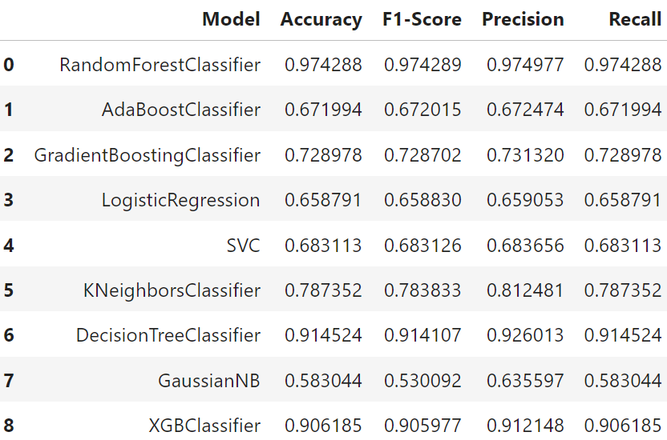
Result
A cardiovascular disease prediction model is made using best predicting model among various classifier model on the dataset. The various models used on the dataset with their accuracy of prediction are given below:

Slide 7
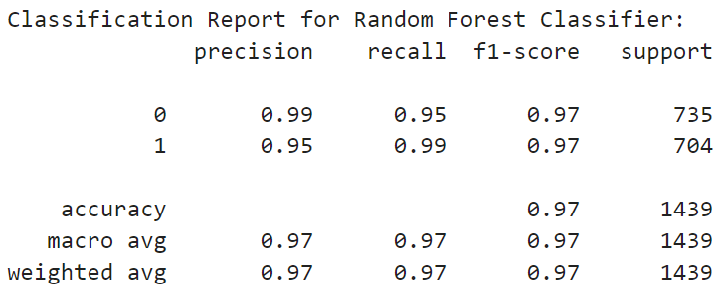
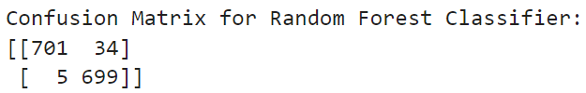
Result
The classifier used to make the prediction model is RandomForestClassifier. The accuracy , classification report and confusion matrix

Slide 8
Conclusion
In this project, we developed a machine learning model to predict the likelihood of cardiovascular disease based on a comprehensive set of features including age, gender, blood pressure, cholesterol levels, and other relevant health metrics. Our model was trained on a dataset of patients [datasets_4123_6408_framingham] and evaluated using rigorous cross-validation techniques.
The results of our model demonstrate promising predictive capabilities. We achieved an accuracy of 0.97, indicating that 97% of predictions were correct. The precision and recall scores of 0.99, 0.95 and 0.95, 0.99, respectively, highlight the model's ability to accurately identify positive cases of cardiovascular disease while minimizing false positives. The F1 score of 0.97 provides a balanced measure of the model's overall performance.

Slide 9
While our current machine learning model for predicting cardiovascular disease has shown promising results, there are several avenues for future exploration and enhancement:
Integration of Additional Data Sources: Incorporating data from wearable devices, genetic markers, lifestyle factors (such as diet and exercise patterns), and socioeconomic indicators could enrich the model's predictive power. This expansion would require robust data integration and preprocessing techniques.
Enhanced Feature Selection and Engineering: Conducting more detailed feature selection and engineering processes could optimize the model's performance. Techniques such as principal component analysis (PCA), feature importance ranking, and domain-specific feature engineering could be explored to identify the most influential predictors of cardiovascular disease.
Utilization of Advanced Machine Learning Techniques: Exploring advanced machine learning algorithms such as ensemble methods (e.g., Random Forest, Gradient Boosting) and deep learning architectures (e.g., neural networks) could potentially improve prediction accuracy and generalize the model across diverse populations.
Deployment in Clinical Settings: Validating the model in clinical settings and integrating it into healthcare systems would require addressing regulatory compliance, ethical considerations, and usability factors. Collaborating with healthcare providers and stakeholders is crucial for successful implementation.
Longitudinal Studies and Real-time Monitoring: Conducting longitudinal studies to assess the model's performance over time and implementing real-time monitoring capabilities could facilitate early detection and personalized intervention strategies.
Interpretability and Explainability: Enhancing the interpretability and explainability of the model's predictions is essential for gaining trust from healthcare professionals and patients. Techniques such as SHAP (SHapley Additive exPlanations) values and model-agnostic methods could be employed for this purpose.
Global Application and Adaptation: Adapting the model to different geographic regions and diverse demographic groups while considering varying healthcare infrastructures and disease prevalence rates is essential for its widespread applicability.
Future scope

Slide 10
References
Wikipedia
Gemini
Youtube

Slide 11

course certificate 1

Slide 12

course certificate 2

Slide 13
THANK YOU

